Slide 1
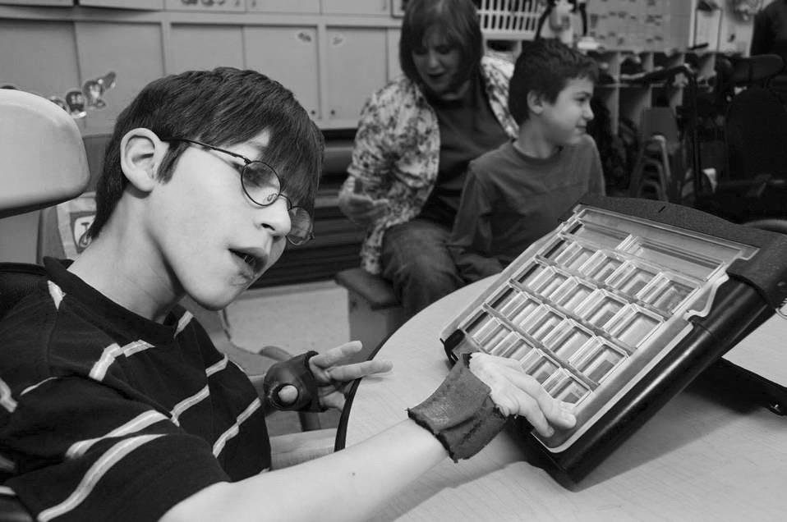
Accessing Text & Content
Wendy Phillips
Jocelyn Washburn
Virginia Department of Education’s
Training & Technical Assistance Center
(T/TAC) @ Virginia Tech

Slide 2
How can students access text and content if they are unable to decode and comprehend on grade level?

Slide 3
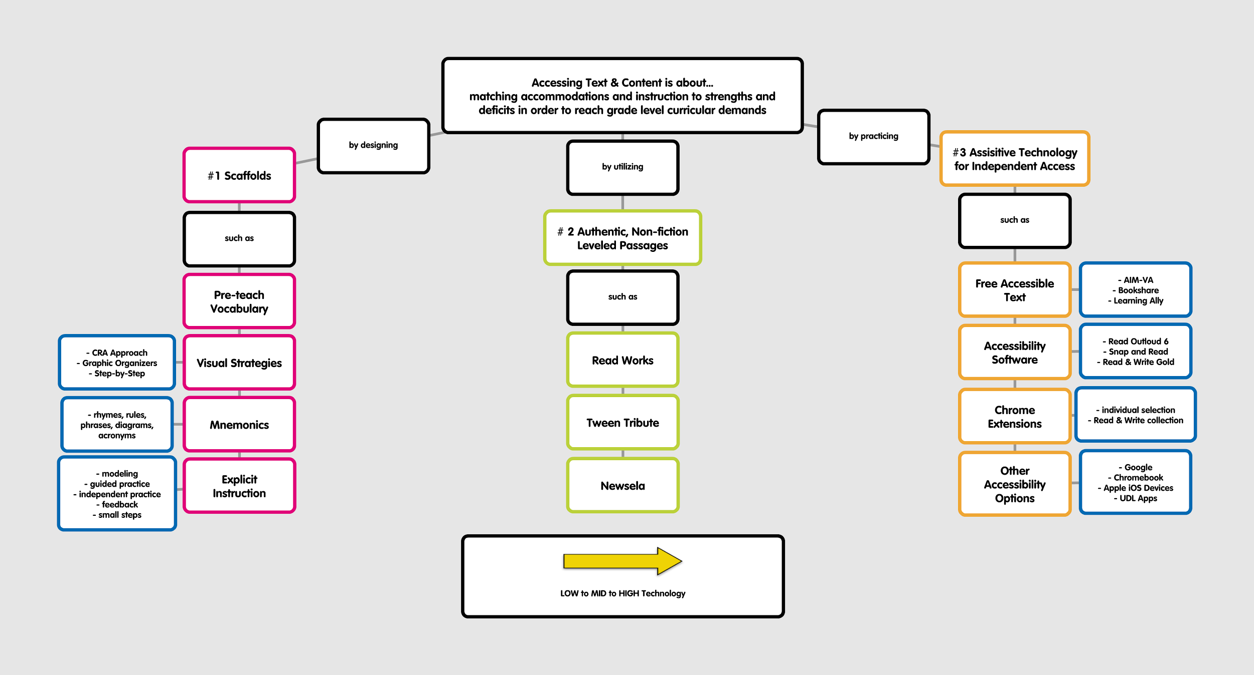
opplet
Notes:
Advanced Organizer & Purpose of our section
Consider the deficits:
•Working memory
•Short-term memory
•Long-term memory
•Concentration/attention
•Auditory processing
•Visual processing
•Visual/motor integration, spatial ability
•Processing speed
•Verbal reasoning
•Non-verbal reasoning
•Abstract reasoning

Slide 4
Making Smart Decisions about AT
S.E.T.T Framework
Student, Environment, Task, Tools
This four-part model is intended to promote collaborative decision-making in all phases of assistive technology service design and delivery from consideration through implementation and evaluation of effectiveness (trialing).
VDOE Assistive Technology Framework
article
chart

Slide 5
opplet
Notes:
Blimblat experience
Consider the deficits:
•Working memory
•Short-term memory
•Long-term memory
•Concentration/attention
•Auditory processing
•Visual processing
•Visual/motor integration, spatial ability
•Processing speed
•Verbal reasoning
•Non-verbal reasoning
•Abstract reasoning

Slide 6
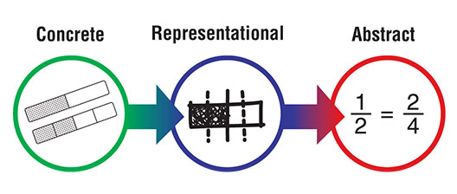
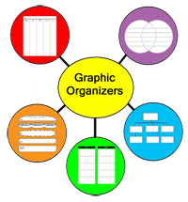
Visual Strategies
Step-by-step

Slide 7
opplet

Slide 8
Mnemonics (pronounced “ne-mon’-ics”) assist the memory by using a system of rhymes, rules, phrases, diagrams, acronyms and other devices – all to help you learn, remember, and memorize names, dates, facts and figures. Most mnemonics work by letting you easily recall a word, phrase or poem, which in turn stands for more complicated information that you need to commit to memory.
www.mnemonic-device.com

Slide 9
opplet

Slide 10
Explicit Instruction
Modeling with think aloud
Guided practice with feedback
Independent practice with feedback
Tasks broken into smaller steps

Slide 11
opplet

Slide 12
Four super-heavy elements to be added to the periodic table
By Deborah Netburn, Los Angeles Times
01.13.16
The periodic table is about to get a little bit longer, thanks to the addition of four super-heavy elements.
The discoveries of elements 113, 115, 117 and 118 were confirmed last week by the International Union of Pure and Applied Chemistry. The group vets the man-made elements seeking a permanent spot on the chart that adorns chemistry classrooms around the world.
The periodic table is getting a little bit longer, thanks to the addition of four new elements.
The discoveries of elements 113, 115, 117 and 118 were confirmed last week by an international scientific group. The group makes sure that the newly discovered elements are real and deserve a permanent spot on the periodic table. The periodic table is a chart listing all the elements. It hangs in science classrooms around the world.
Scientists just discovered four new elements. Elements make up all matter. They cannot be separated into smaller things.
Elements are made up of atoms. Atoms are like building blocks. At the center of each atom is a nucleus. The nucleus is made up of small pieces. The pieces are called protons and neutrons.
The new elements are known as 113, 115, 117 and 118. A science group confirmed their finding last week.
NEWSELA
Notes:
12th grade, max Lexile
6th grade, 940 Lexile
3rd grade level, 580 Lexile
frequency of word in corpus of English language
sentence structure and length

Slide 13
Authentic, Nonfiction Leveled Passages
ReadWorks
TweenTribune
Newsela

Slide 14
opplet

Slide 15
Reading Programs
Available for Check-out
https://www.ttac.vt.edu/Resources/Literacy_PDF_Files/literacyprograms_PDF.pdf
Notes:
Running records
Show leveled books
T/TAc Reading programs

Slide 16
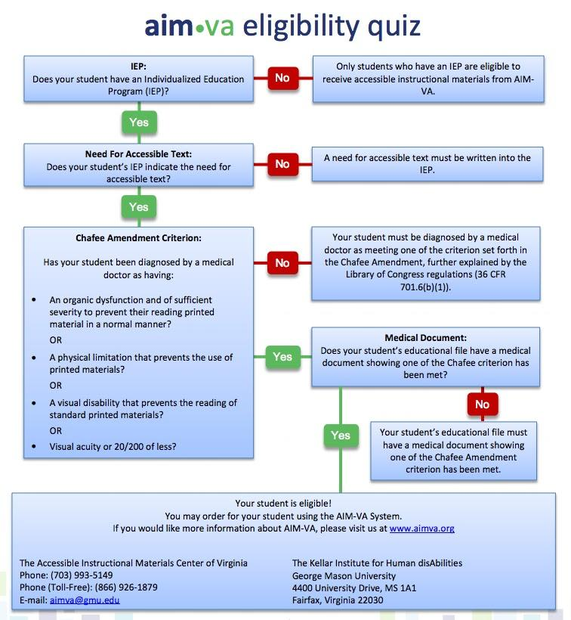
Accessible Instructional Materials
Free accessible textbooks & other reading materials to eligible K-12 students with IEP’s in VA (not through third party like Amazon though)
AIM-VA

Slide 17
Bookshare is an online library that makes print material available for people with print disabilities.
Bookshare & AIM-VA have created a collaborative partnership to offer greater access to electronic instructional materials.
internet archives with over 3 million DAISY files
daily updates from newspapers and magazines
ability to read on a portable device (third party app - Read2Go)
unlimited book downloads
Bookshare

Slide 18
Read2Go App
The most accessible e-book reader app for individuals with print disabilities and it works with Bookshare.
$19.99
https://www.youtube.com/watch?v=kcQOmPDjw9g

Slide 19
Accessible reading materials for students with print disabilities because of a visual impairment, learning disability, or other physical impairment. Qualified students with IEP have state-funded access.
ability to use the free Learning Ally Audio App (iOS & Android)
over 80,000 titles available
ability to use access accounts at school, home and on-the-go
unlimited downloadable books
access to free book playback software
access to growing list of VOICEtext books with visible, synced text highlighted at the sentence level
Learning Ally

Slide 20
opplet

Slide 21
Access Text & Content
Demo Video
Notes:
This is a sample of what different features that may be available through various software and accessibility features built in to a device.

Slide 22
Software with a customizable toolbar that integrates reading, writing, studying, and research support tools with common applications
$650 software 1 user, $295 student with IEP, $5000 unlimited access license
Demo Video
Read&Write Gold
Check out from the T/TAC @ VT lending library
Notes:
Show video

Slide 23
Demo Video
Read Outloud Tutorial
Check out from the T/TAC @ VT lending library
Free with AIM-VA account
Provides access to any book file & to the internet

Slide 24
Reads text aloud on Google Drive, email, websites & PDFs
Dynamically levels text
Translates text into over 90 languages
Demo Video
Snap&Read
Check out from the T/TAC @ VT lending library

Slide 25
Turn & Talk
How could accessibility software and free accessible text improve independent access to text/content?

Slide 26
opplet

Slide 27
Google Chrome
A web browser that allows bookmarks, applications & extensions follow you

Slide 28
What are Chrome Extensions?
Extensions are custom features and functionalities that you can add to Google Chrome. Unlike apps, they’re always available, no matter what website you’re on.

Slide 29
How to install Chrome extensions
Visit the Chrome Web Store.
Find and select the extension you want to install.
Click Add to Chrome.
A dialog will appear to show you data that the extension will be able to access.
Click Add to grant the extension access to your data and install the extension.
To use the extension, click the icon that will appear on the right of the address bar.

Slide 30
Speak it!
On most websites, just select the text you want to be read out loud and click on the Speakit! extension button. Voice is clear and can work with over 50 different languages.
Link to extension

Slide 31
Super Simple Highlighter
This extension allows you to highlight any webpage and the highlighted page can then be shared with your students. Just find a great article for your class, click the yellow highlighter, highlight the important information, and share the url with your students.
Link to extension

Slide 32
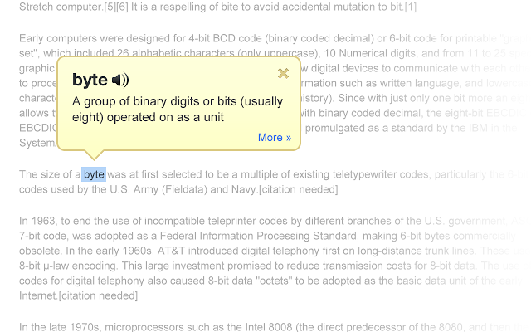
Google Dictionary
As you browse the web, you can easily look up words without going to a different page.
Link to extension

Slide 33
Ginger Spell and Grammar Check
The Ginger extension will help with spelling and grammar in your emails. Errors will be highlighted and with one click corrections will be made.
Link to extension

Slide 34
Read & Write for Google
Chrome Extension
This extension allows for read aloud of websites and Google Docs and also includes word prediction, image dictionary, highlighter, and much more for premium memberships.
Link to extension
Demo Video
Notes:
Play video

Slide 35
Premium Account is FREE to all teachers with a Google Apps for Education Account
Video Demo
Sign up
Notes:
Break to set up free account

Slide 36
Students get a 30 day FREE trial!
After 30 days, students can still access the Read Aloud and Translator features in Google Docs and web pages. Premium features for Google Docs, web pages, PDF, EPUB, and KES files are available by purchasing a subscription for single users, groups of users, or domains.
Single Student $ 100
Group (minimum of 150 students within the same domain/district but could be at different schools) $10
Domain (minimum of 350 students) $1.50

Slide 37
Toolmatcher
Toolmatcher can help with pairing a student's accommodation needs with the appropriate support features built right into Read&Write for Google Chrome™.
Use the Toolmatcher to select the tools within Read&Write for Google Chrome™ that best match a student's learning style. Then click the "See how Read&Write can help" button to create the student's personalised Read&Write for Google Chrome™ user guide.
https://www.texthelp.com/en-us/products/toolmatcher-read-write-for-google
Notes:
Click and show

Slide 38
Turn & Talk
How could Google Chrome extensions improve independent access to text/content?

Slide 39
opplet

Slide 40
Google Accessibility features
Google Accessibility Products & Features

Slide 41
Resources:
Essential Resources Guide
Google in Your Classroom
Google Training Center

Slide 42
Chromebook Accessibility features
How to turn on accessibility features on chromebook

Slide 43
Apple’s iOS
Accessibility Features
Accessibility Features

Slide 44
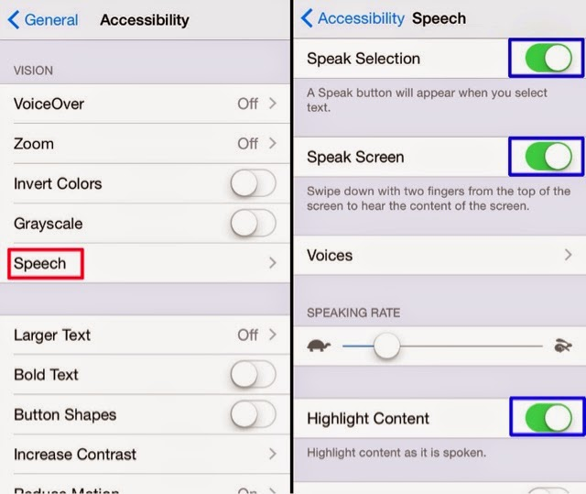
Speak Screen and Speak Selection
Assists with reading emails, web pages, and books to you
Two finger swipe from top down or just tell Siri to Speak Screen
Adjust the voice’s dialect and speaking rate, and have words highlighted
Turn on Speak Selection and hold your finger down over a word to highlight
Drag the bottom right dot over your text, select speak from popup to hear the highlighted text
When using Safari, select “Reader View” to reduce distractions or reading of unnecessary text from Ads.

Slide 45
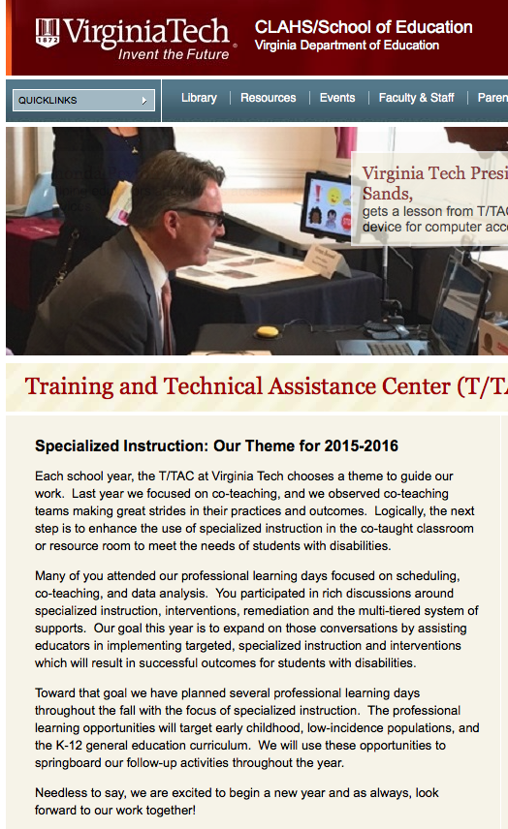
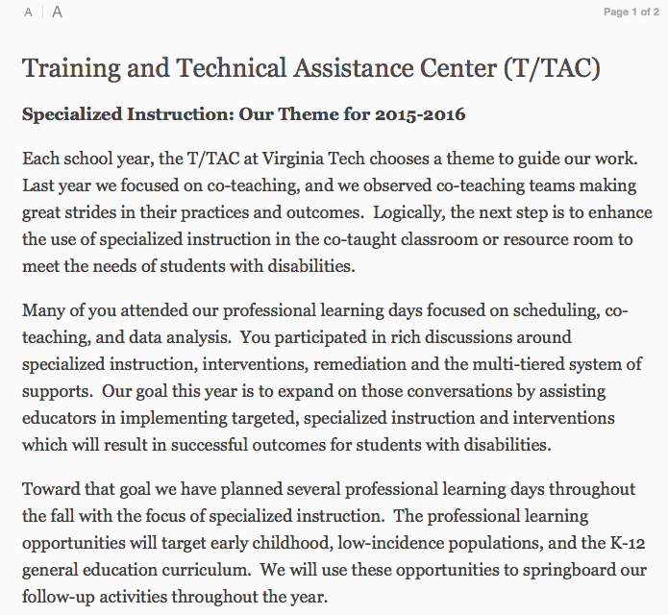
Safari Reader View
Minimizes distractions and sensory overload
Safari Reader reduces the visual clutter on a web page by removing distractions
Safari Reader works with Speak Selection and Speak Screen

Slide 46
Free alternative keyboard with integrated features for writing and reading support
speak as I type
word prediction
talking & picture dictionary
spell checker
Read&Write iPad

Slide 47
A Placemat of Core Apps Serving Learning for All
Universal Design for Learning (UDL)

Slide 48
The iTunes
Special Education
App Collection
Browse the special education app collection and discover amazing apps for every need — from sign language and communication to emotional development and life skills.

Slide 49
100 Free Apps
for Dictation

Slide 50
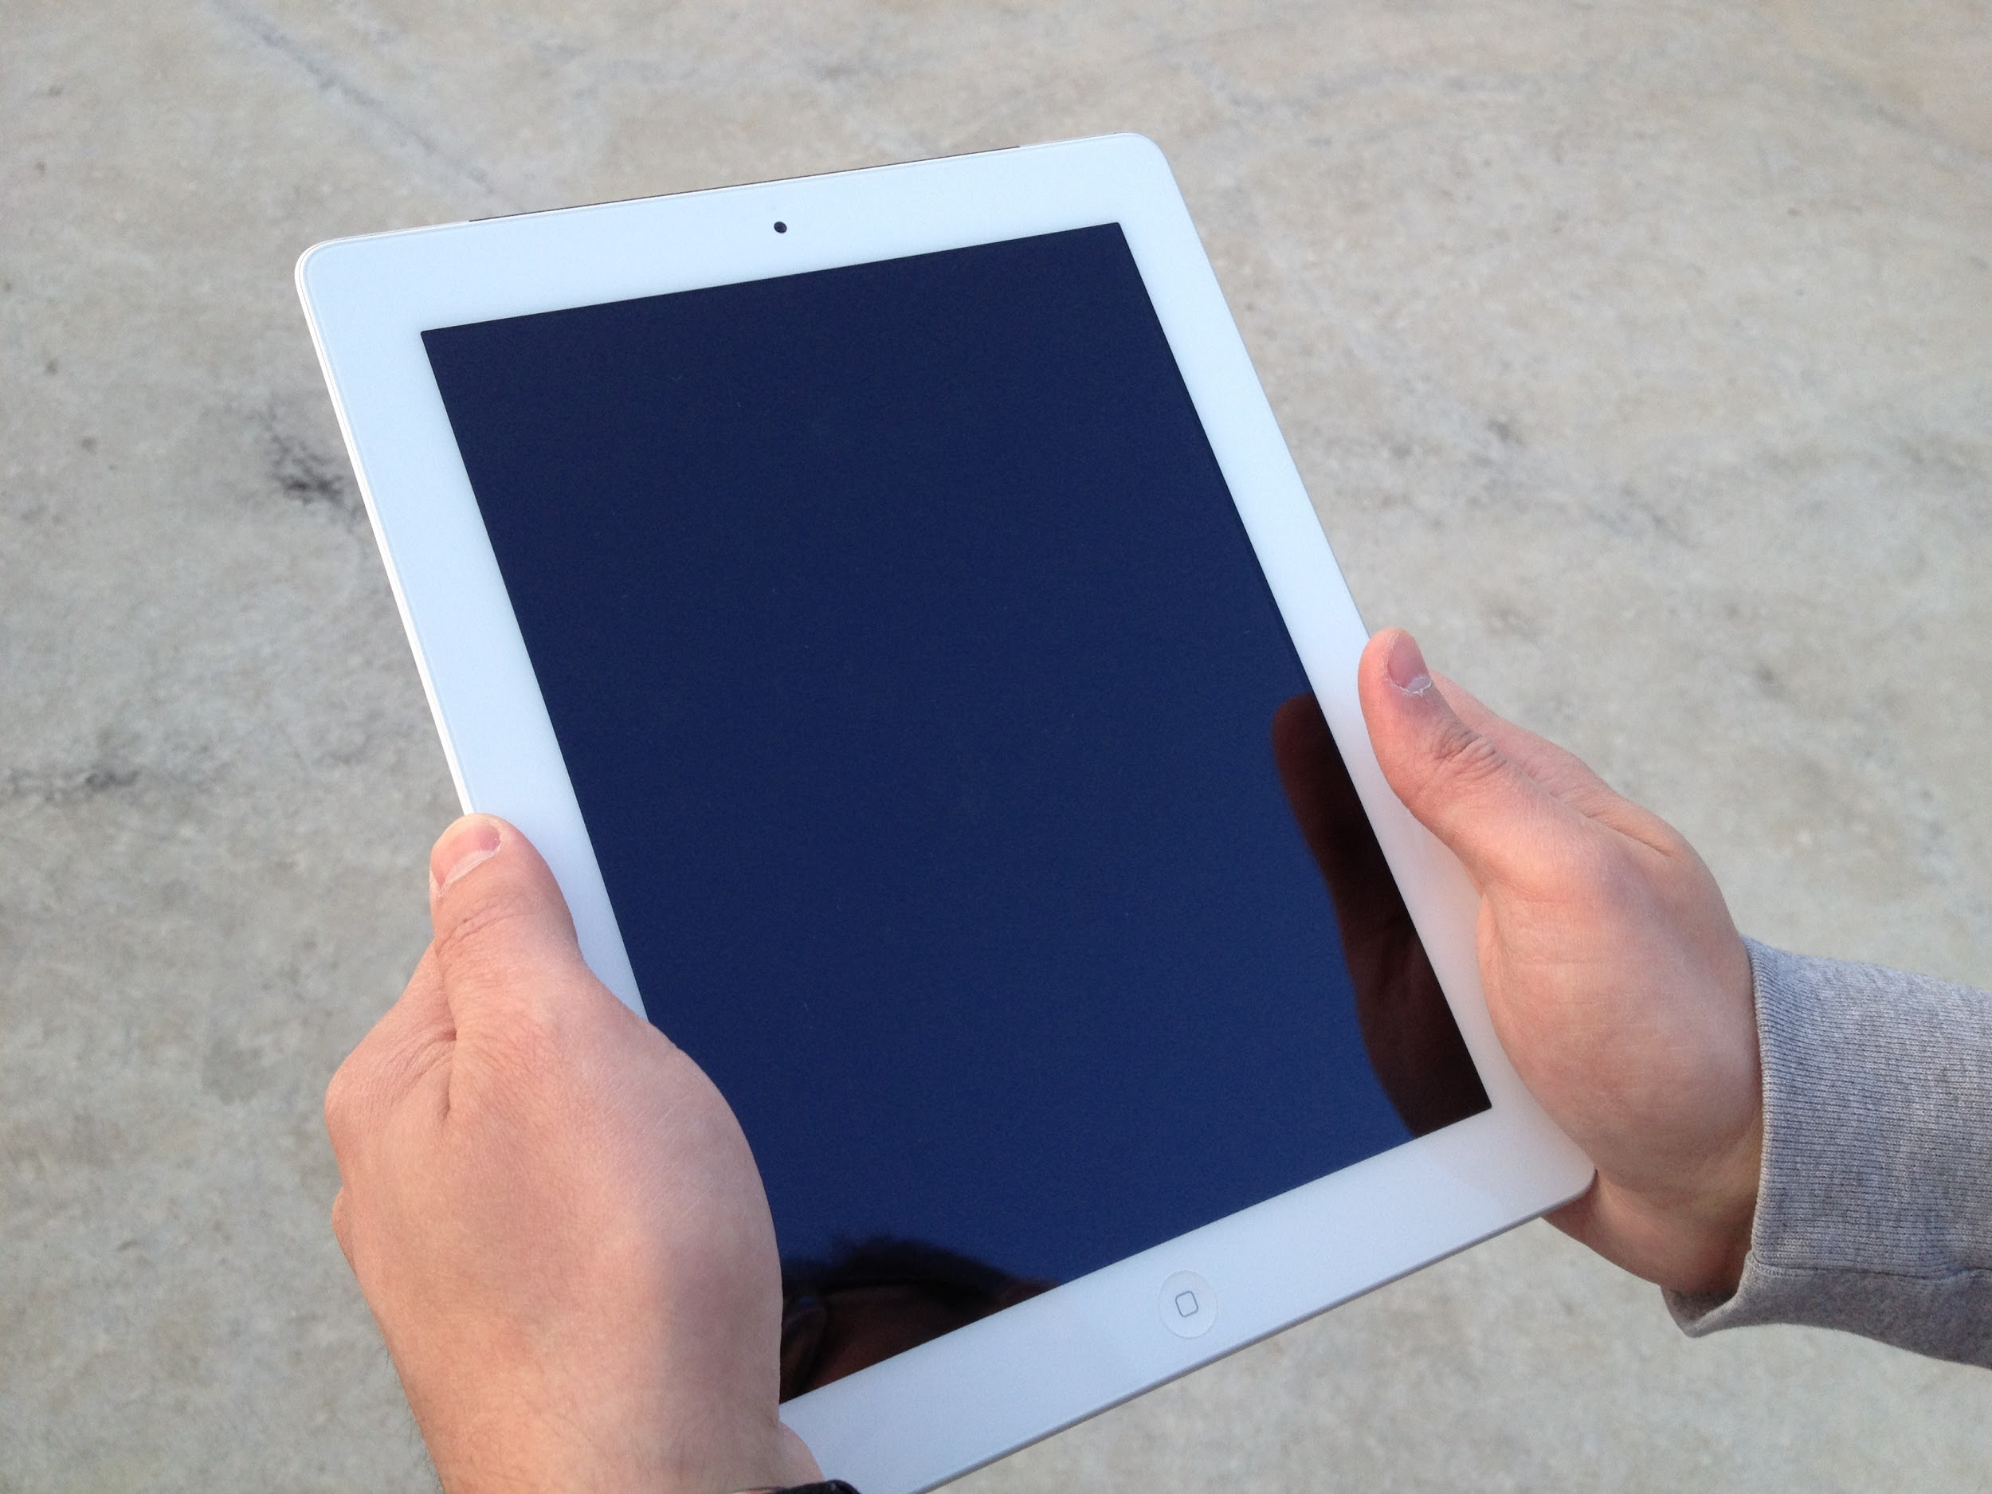
Hands-On with
Assistive Technology

Slide 51
How can students access text and content if they are unable to decode and comprehend on grade level?
Notes:
Request T/TAC support based on unique student and situation
Practicing with AT in school will lead to successful post-secondary use

Slide 52
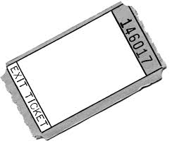
Exit Ticket

