Slide 1
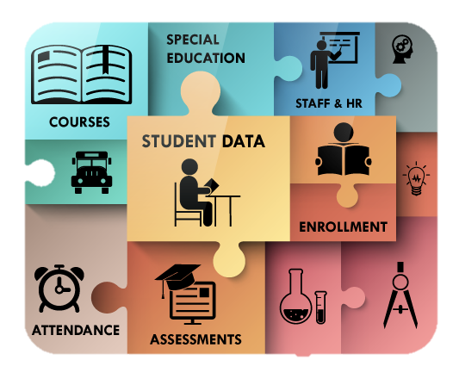
DATA, DATA, DATA
Notes:
This slide represents many of the data points you use in your schools. Data is any information that can be used to inform practice, pinpoint student learning challenges, or guide and monitor progress and improvement.
The objective is to gain ideas for using data to improve instruction so we can address student learning challenges.
What data points are you currently using to help you write your IEP goals and design instruction to meet the unique needs of your students?
Page 63 RTI is a Verb

Slide 2
RTI is a Verb
Data analyses, collaboratively driven by teacher teams with a sense of urgency for student success, are the engines that drive schools. B
y teacher teams with a sense of urgency for student success, are the engines that drive
RTI is a Verb, pg. 63
schools. pg. 63

Slide 3
What is Progress Monitoring?
Progress monitoring is regular and systematic monitoring of student results and progress to determine if students are benefitting from instruction and intervention, and if not, to inform instruction and intervention that is more effective. It is followed by diagnostic feedback to students on their learning progress to guide their learning and close any gaps.
Hierck & Weber 2014
Notes:
http://www.studentprogress.org/progresmon.asp#4
We analyze multiple data points and then write goals as our first course of action, but we have to continually progress monitor to make sure we are meeting the student’s needs and to ensure the student is making progress toward meeting the goal(s).
Pages 6 & 7 in RTI is a Verb

Slide 4
Notes:
PM is an ongoing process. We have to consider each of these questions when developing goal(s).

Slide 5
Notes:
The purpose behind progress monitoring is making sure the student is making growth and we are communicating this growth to all stakeholders.
Discuss what participants are currently using for PM and report out on whiteboards.

Slide 6
Notes:
http://www.interventioncentral.org/sites/default/files/rti_tier_1_teacher_data_collection_form.pdf
www.interventioncentral.org
If you need a resource to help you start the process of PM, here is a resource that will walk you through step-by-step the essential components of PM.

Slide 7
Sample IEP Goal
# __2___ MEASURABLE ANNUAL GOAL:
By the end of the third nine weeks, using graphic organizers for planning, Amanda will produce well developed essays with a central idea, a variety of sentence structures and vivid vocabulary with 80% accuracy as demonstrated on 7 out of 10 completed writing samples.
Notes:
With a partner or individually, have participants work together using the RTI Classroom Progress-Monitoring Worksheet
to come up with a plan of action for how they will progress monitor this writing goal for the student.
Have participants share out.

Slide 8
Notes:
http://www.onsetasc.org/resources.cfm?subpage=1357425
Share this progress monitoring form and link with participants, and how we found additional ideas and resources online.

Slide 9
Notes:
We have talked about PM from the teacher perspective. Now let’s discuss progress monitoring from the student perspective. Providing students with a visual and having them plot their progress makes the skill or goal they are working on meaningful. Students become more aware of their own performance; they can see how they are progressing. Do any of you have students PM goals or skills?

Slide 10
RTI is a Verb
The more information we share about each student, the greater the likelihood we will identify the interventions that will produce positive results for each student. Collaboration is key.
RTI is a Verb, pg. 51
Notes:
The following quote from RTI is a Verb stresses the importance of collaboration, PM, and communication among all stakeholders.

Slide 11
http://www.studentprogress.org/progresmon.asp#4 http://www.onsetasc.org/resources.cfm?subpage=1357425 http://www.rti4success.org/sites/default/files/RTI%20PM%20Manual_web_w_handouts.pdf http://www.interventioncentral.org/sites/default/files/rti_tier_1_teacher_data_collection_form.pdf www.interventioncentral.org
Notes:
Resource links
http://www.rti4success.org/sites/default/files/RTI%20PM%20Manual_web_w_handouts.pdf

Slide 12
As far as what you learned today, what do you still need to know?
What are your next steps to transfer today’s new learning into the reality of your school/division?
Notes:
Thank you for being here and sharing your knowledge and expertise. We always love these days because we learn so much from each of you. We hope that you will take this information back and share it with others in your school or division. If you need additional support, you can always call Rhonda and get her to send you a request for services packet.

